Slide 1

CONNECTICUT
Connecticut Sales Analysis
Capstone 1: Business Analysis with SQL and Excel
EmporiUm | In-store territory | East region
Betelhem Tamirat

Slide 2
Agenda
Connecticut: in-store sales analysis
1
Scenario
2
Presentation Overview
3
Key Findings
4
Sales Over Time
5
Sales Performance
6
Regional Comparison
7
Summary Stats
8
Relationship Analysis
9
Key Findings and Recommendations

Slide 3
Scenario
As a data analyst for EmporiUm, a student bookstore chain, I analyzed in-store sales for the Connecticut territory (East region) to answer the sales manager's questions and recommend where to focus sales next quarter.
EmporiUm is a growing student bookstore chain that also sells tech products, art supplies and other products, in-store and online
Sales are segmented by region, and within each region by sales territory (in-store or online, covering one or more states)
A sales manager asked me for information about my assigned territory
My assignment: in-store sales performance for Connecticut, in the East region
I answer with SQL queries, an Excel PivotChart, a video demo and this presentation

Slide 4
Presentation Overview
1
What is the total revenue for the territory, and what start and end dates does the data cover?
2
What is the revenue breakdown by year and month?
3
How does the territory's revenue compare with the region it belongs to?
4
What is the number of transactions per month and the average transaction amount by product category?
5
How do the stores rank by in-store sales performance?
6
Where should we focus sales attention in the next quarter?

Slide 5
Key Findings
$2.39M
+121%
2x
Connecticut total revenue, 2022 to 2025
Revenue grew from $399K (2022) to $884K (2025)
NY $4.3M vs. CT $2.4M: CT is 35.58% of East
Close stores
New London
Promotions
No store far ahead of or behind the others
Top store, then Bridgeport and Hartford
State-wide promotions, seasonal campaigns and marketing

Slide 6
Sales Over Time
2022 total
2023 total
2024 total
2025 total
$399K
$553K
$556K
$884K
Starting point
+38.5%
+0.5% (flat)
+59.0%

Slide 7
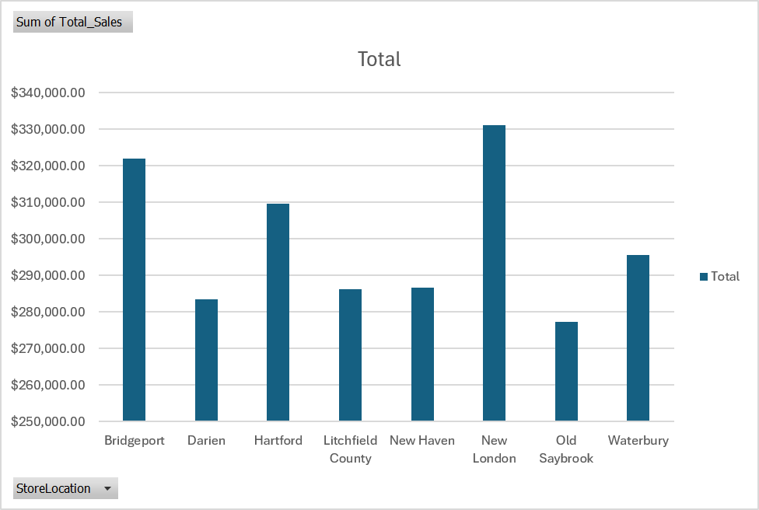
Store Sales Performance
Excel PivotChart: total sales by Connecticut store
New London leads (about $331K), then Bridgeport (about $322K) and Hartford (about $309K)
Lowest: Old Saybrook (about $277K)
The axis starts at $250K, so gaps look larger than they are

Slide 8
Regional Comparison
Connecticut covers 35.58% of the East region and is at 71% of the East average. New York earns almost 2x, so Connecticut has room to grow.

Slide 9
Summary Stats: Whole DB and Connecticut
Benchmark: whole database
$45.37M
2022-2025
Total revenue
Data period
KPI: Connecticut (in-store)
$2.39M
5.3%
Total revenue
Share of whole DB
KPI = Connecticut total revenue. Benchmarks = whole database, East average and New York.

Slide 10
Relationship Analysis
Connecticut stores
New York vs. Connecticut
Almost the same
Almost 2x
No store stands out
Same management and sales methods, so similar results
New York earned about twice as much
Suggests a difference in management policy, store management or promotions
How we manage is related to the results we get: to close the gap, look at how New York manages and promotes.

Slide 11
Findings & Recommendations
Findings
Connecticut vs. East: New York earned $4,330,817.09 and Connecticut $2,392,222.44, so New York sells almost twice as much
Inside Connecticut: sales are almost equal among stores; none is far ahead or behind, so Connecticut performs as one balanced territory
Recommendation
Grow Connecticut as a whole state, not by fixing one weak store
State-wide promotion, plus an online and in-store back-to-school campaign
More marketing for the best-selling product categories (Q4)
Copy New York's best practices to close part of the gap

